Slide 1
Presentation 2
Yelp

Slide 2
Task Completed
added new objective to our project, show the user not only the highest rating restaurants, but also the information of the famous dishes.
use curl and for loop to get 10 pages of restaurant data from yelp
use regular expression to get the location, name, rating and name of dishes in the review.

Slide 3
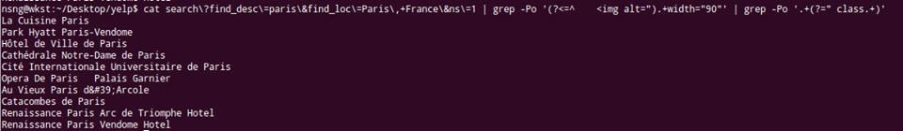
Restaurant name

Slide 4
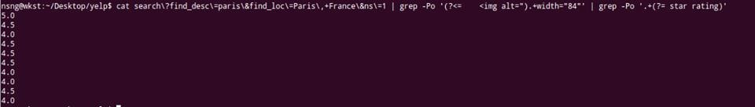
star rating

Slide 5
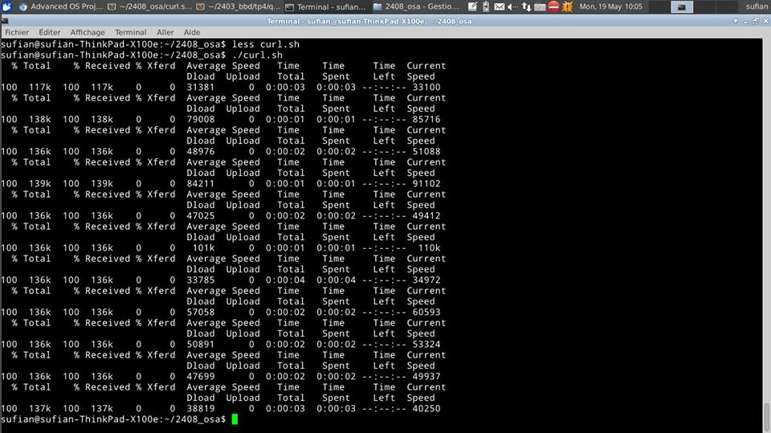
getting 10 pages of data with a for loop
for i in {0..100..10}; do
curl "http://www.yelp.fr/search?find_desc=restaurants&find_loc=Paris&ns=1&start=%24i" > $i.html
done;

Slide 6
Problem encountered
Different machines may have different results when using grep to extract useful data
Some machines are using BSD Grep instead of GNU Grep. BSD Grep does not support perl regular expression, it makes the extraction of data becomes difficult
We decide to use sed instead because sed support grouping while grep does not
The advantage of grouping is to allow us to get useful data in large amount of data efficiently

Slide 7
Progress
Successfully combine two scripts into one
#!/bin/bash
for i in {0..100..10}; do
echo $i
rname=$(cat $i.html | sed -n 's/ <img alt="\(.*width="90\)/\1/p' | sed -n 's/\(.*\)" class=.*/\1/p')
rating=$(cat $i.html | sed -n 's/ <img alt="\(.*width="84\)/\1/p' | sed -n 's/\(.*\) étoiles.*/\1/p')
db="$rname, $rating"
echo $db
done;

Slide 8
